Slide 1
Data Wrangling in Python
Crissy Neff

Slide 2
Overview
Data Preprocessing
Research in Preprocessing
Pandas
Scikit Learn
Walkthrough
Future of Preprocessing
Conclusion
Questions
Reference

Slide 3
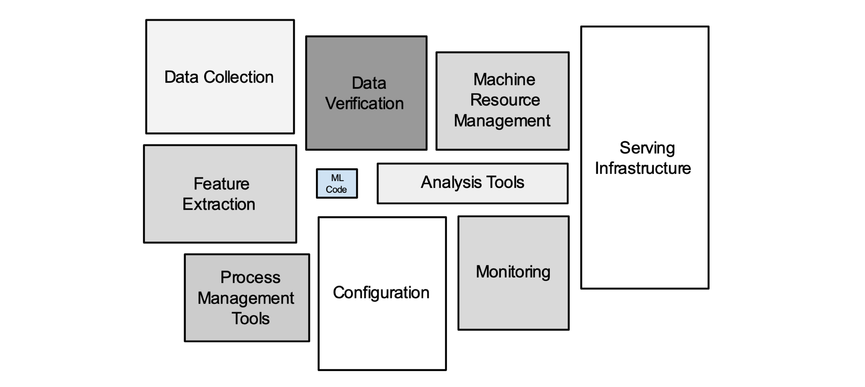
Preprocessing in relation to ML code

Slide 4
Data Preprocessing
Data preprocessing takes messy data and makes it useful
Seek raw data sources and determine value:
How good are they as datasets?
How relevant are they to your goal?
Is there a better source?
Parse and clean data
Data is ready for analysis
This allows you to take data no one would bother looking at and make it both clear and actionable.
Kazil, J., & Jarmul, K. (2016). Data Wrangling with Python . O'Reilly Media, Inc.

Slide 5
Data to Clean
Preprocessing Steps
Noise
Data entry errors, duplicate entries, unreal values (Jan 1,1970—anyone know what that is?)
Outliers
Tricky to handle; can affect outcomes of data
Unbalanced
Several approaches, varies for each situation
Scaling Data
Binning Data
Discretization
Missing Data
Notes:
Noisy values need to be removed or reformatted altered to be useful values
Outliers should have a predefined way of identifying and handling
Unbalanced data – resample data, generate synthetic samples, academy awards example – good a predicting losers, but lack of winners made the system volatile

Slide 6
Articles Regarding Preprocessing
Impact of functional MRI data preprocessing pipeline on default-mode network detectability in patients with disorders of consciousness.
Gradually add pre-processing filters to efficiently identify disease
Optimization of miRNA-seq data preprocessing
Recommend specific preprocessing steps for miRNA-seq data; no clear consensus
An efficient data preprocessing approach for large scale medical data mining.
Suggests that instance selection and small sized training applied to large testing is most efficient
A systematic map of medical data preprocessing in knowledge discovery.
Considerable amount of time goes into preprocessing medical data because of inconsistency
So much data in the medical field urges for standardization

Slide 7
Pandas Library
https://pandas.pydata.org/
Quick data frame manipulation
Read and write data
Reshape data
Feature Selection and Extraction
Limited functionality outside linear and panel regression

Slide 8
SciKit Learn
https://scikit-learn.org/stable/index.html
Built on NumPy, SciPy, and matplotlib
Preprocessing package:
Scaling
Non-linear transformations
Categorical encoding
Dimensionality reduction
Principal Component Analysis (PCA)
Feature Selection
Notes:
Now that you’ve all been hazed into writing your own code for cross validation, you have no use for Scikit Learn.

Slide 9
Jupyter NoteBook Walk Through
Time for some fun!

Slide 10
Research Credit to Samir
Challenges:
Not all data preprocessing works with all data sets and ML algorithms
Preprocessing techniques take a lot of time when running on big data
Data preprocessing is a major component of any ML project, not ML algorithm selection
In web, videos/data streaming projects, techniques need to be very fast. In web, we need online techniques.
What has been done:
Many algorithms have been developed for generic or for specific problems
Open areas:
Solutions for the ongoing challenges
New algorithms may be modified, to tackle new domain-specific problems.

Slide 11
Conclusion
Data preprocessing is essential in data analysis
Noise, outliers, etc. can affect outcomes of data analysis

Slide 12
Useful Information
O’Reilly Subscription is Free* through the U of U library
Lots of Math and Coding eBooks available
Data School on YouTube is a great walk-through resource for Pandas
Anything not referenced in this presentation I learned in my Data Science Course (and Ram). Check out this GitHub repository if you have time: https://github.com/datascience-course/2019-datascience-lectures.git
*(because you pay tuition, so not really “free”)

Slide 13
References for Articles
Andronache A, Rosazza C, Sattin D, et al. Impact of functional MRI data preprocessing pipeline on default-mode network detectability in patients with disorders of consciousness. Front Neuroinform. 2013;7:16.
Shirley Tam, Ming-Sound Tsao, John D. McPherson, Optimization of miRNA-seq data preprocessing, Briefings in Bioinformatics, Volume 16, Issue 6, November 2015, Pages 950–963, https://doi.org/10.1093/bib/bbv019
Hu Y-H, Lin W-C, Tsai C-F, Ke S-W, Chen C-W. An efficient data preprocessing approach for large scale medical data mining. Technology And Health Care: Official Journal Of The European Society For Engineering And Medicine. 2015;23(2):153-160. doi:10.3233/THC-140887.
A. Idri, H. Benhar, J.L. Fernández-Alemán,I. Kadi, A systematic map of medical data preprocessing in knowledge discovery. Computer Methods and Programs in Biomedicine. August 2018

Slide 14
Questions?
Experiences to Share?
Examples?
Preferences?

